Slide 1
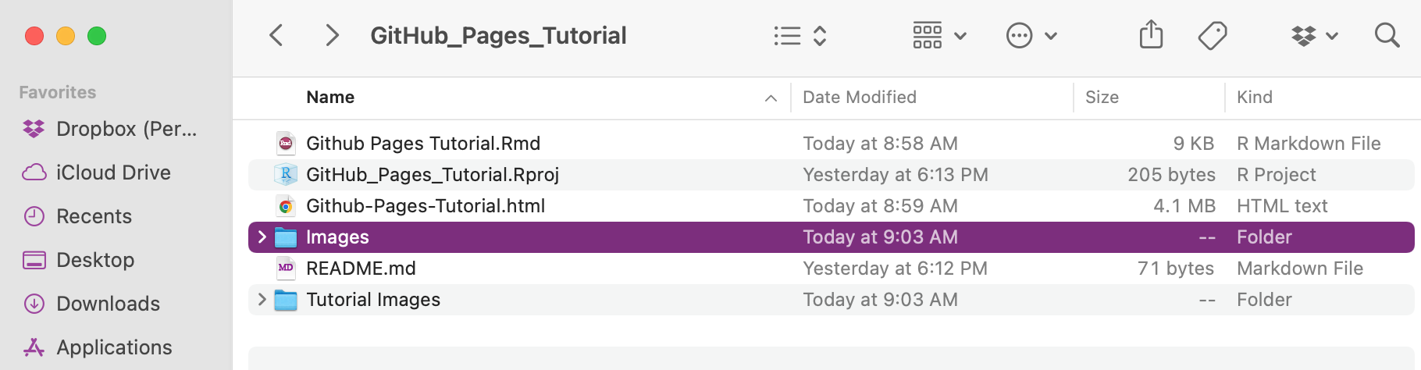
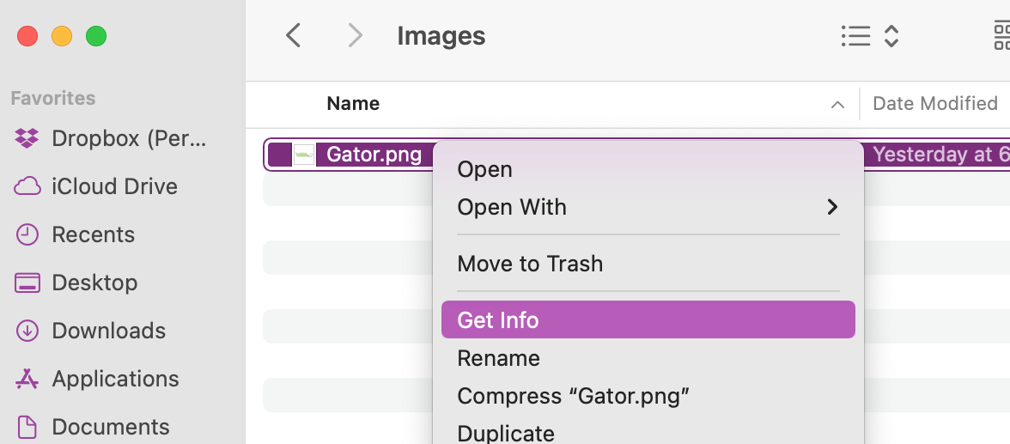
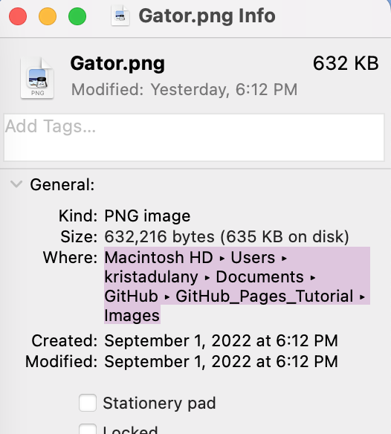
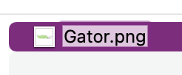
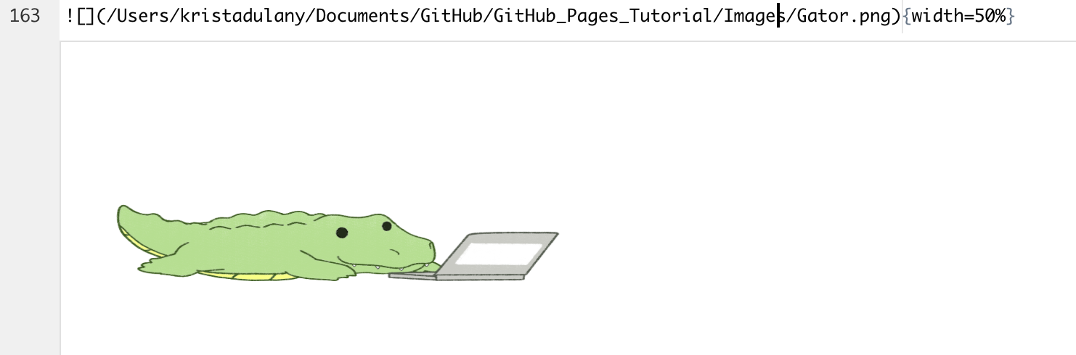
1 Go to File
2 Select File and “Get Info”
3 Copy File Path & Paste Into Code
4 Complete File Path by adding “/file name.file type” to the code

Slide 2
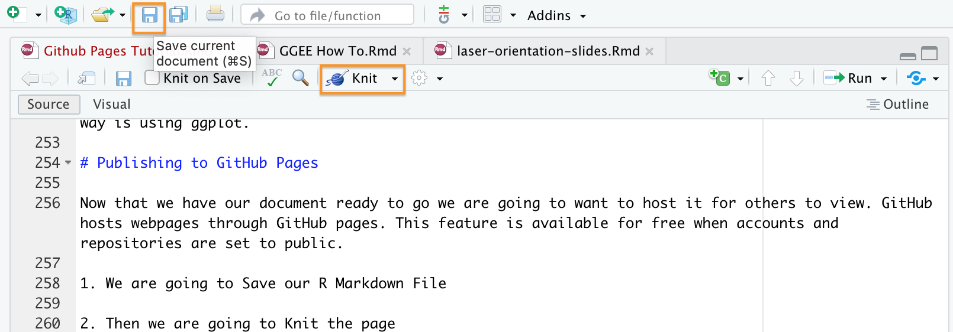
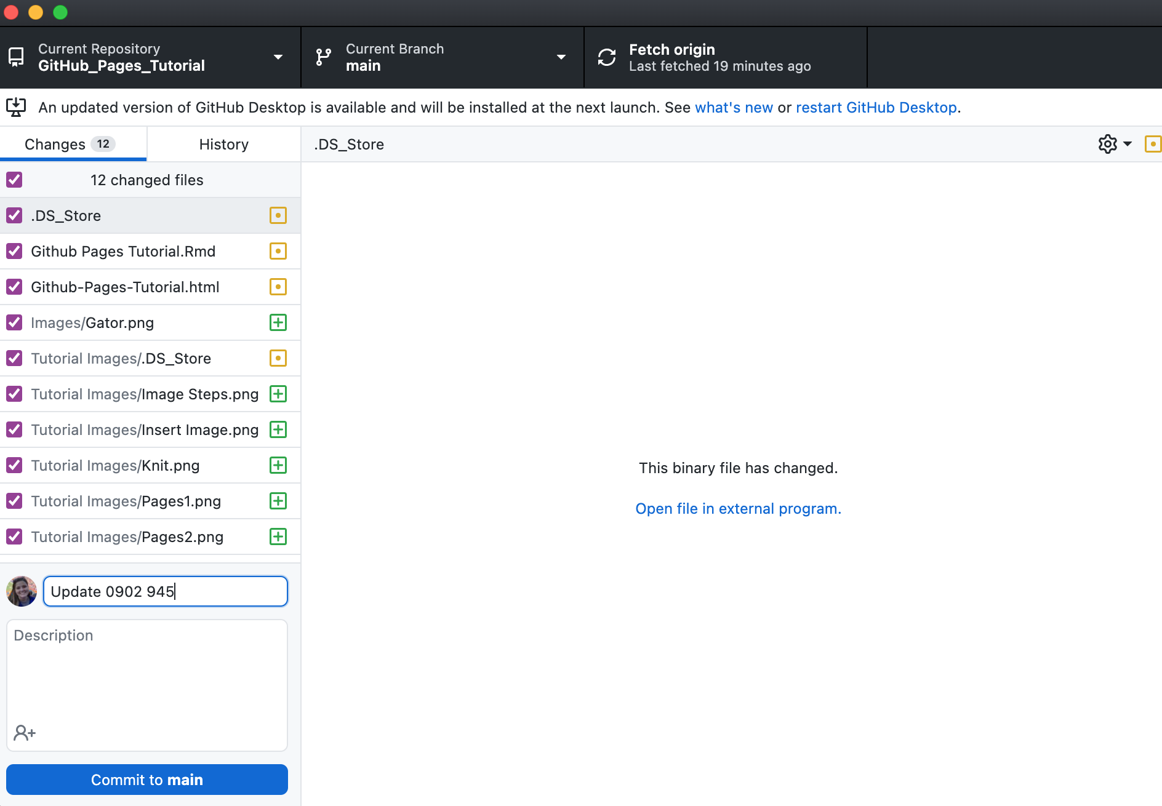
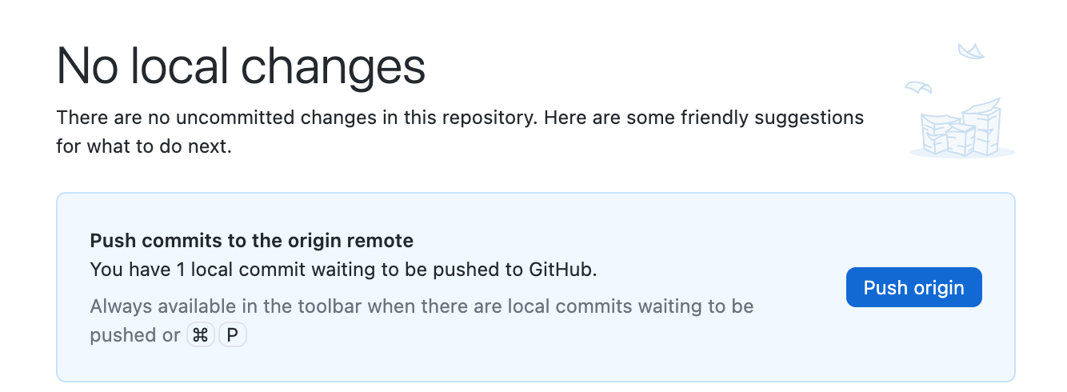
1 Save & Knit
2 GitHub Desktop & Commit
3 Push Changes
< Update Name

Slide 3
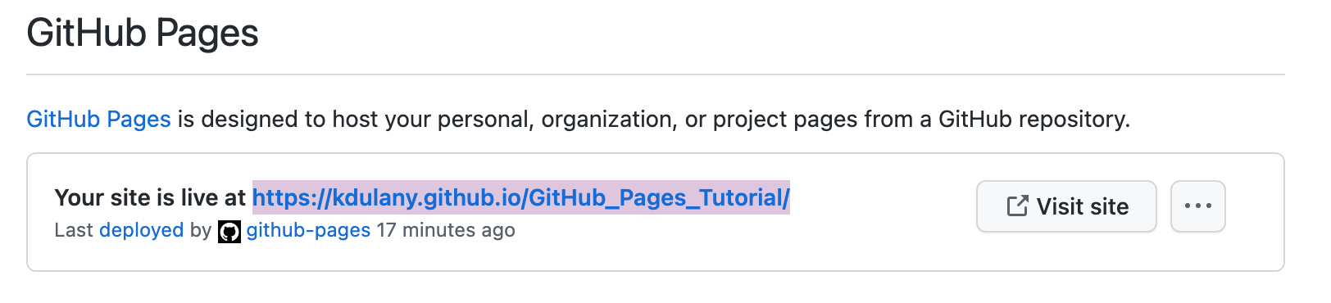
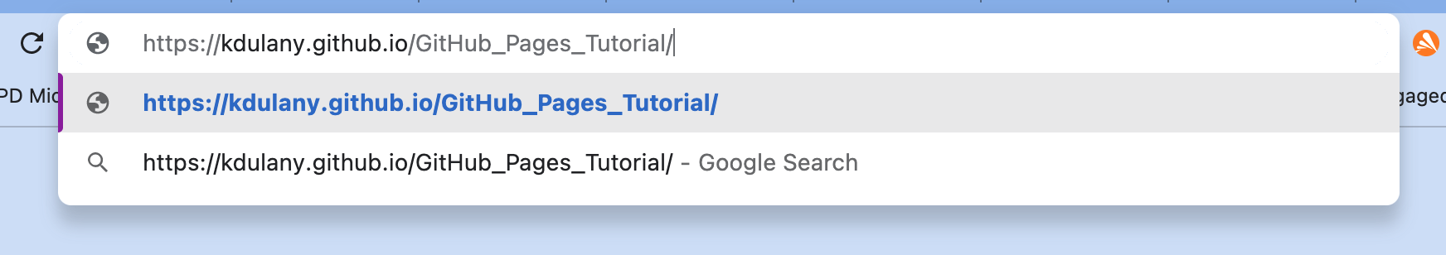
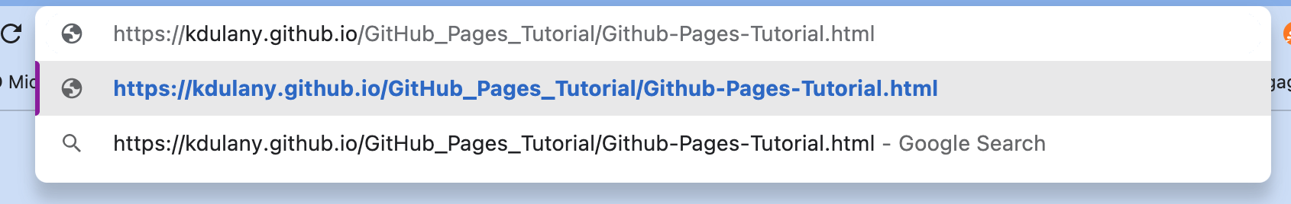
1 Get Link
2 Paste into empty browser
3 Get directory to HTML file we worked on
4 Add to end of URL
Congrats on your new page!!

